Slide 1

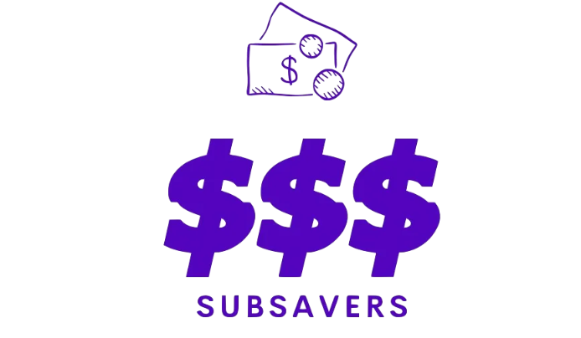

Area: Financial technology
Maryam Almetnawy
Ameera Saeed
Aya Hmoud

Slide 2
[1] Statista
Problem Statement
[2] Yahoo Finance
avg person loses nearly
$400/year
85.7%
on unused services
$33
have at least one paid subscription unused each month
[2]
in 2024
monthly average of unused paid subscriptions
[1]
[1]

Slide 3
AI financial assistant that identifies underused subscriptions and sends cancellation reminders

Slide 4


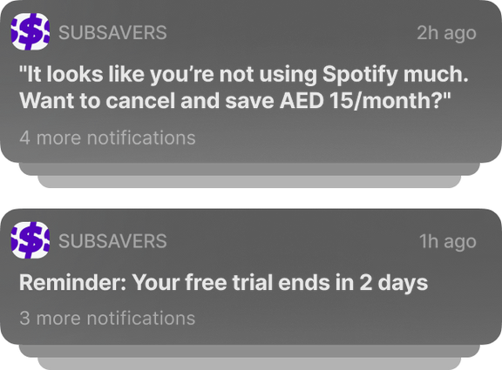






How does SubSavers function?
SOURCES
DB
ETL
ML & AI
INTERFACE
susbscription. tyoe
renewal dates
payment history
Usage Analysis Clustering
&
Recommendations
if > 20 days unused
usage times
inactive subscription
free trials detection

Slide 5
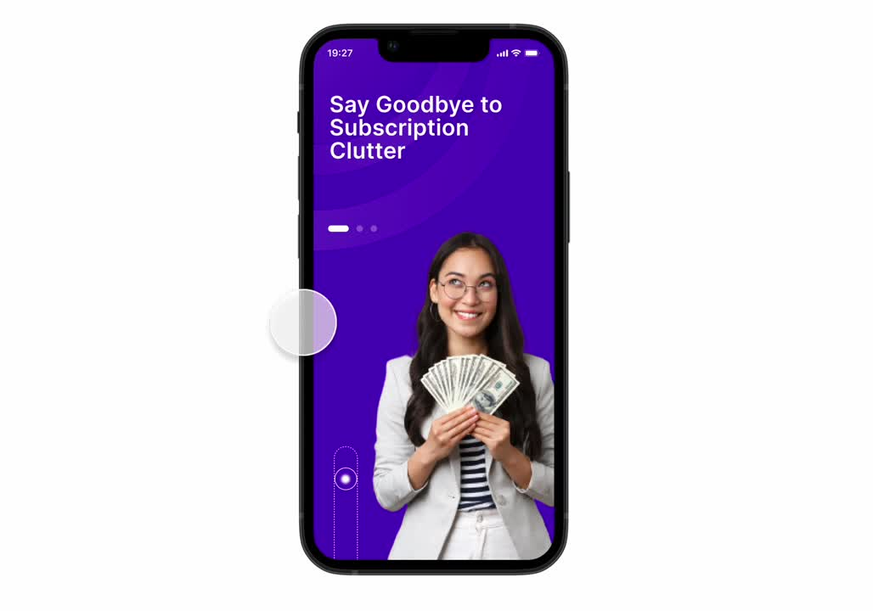
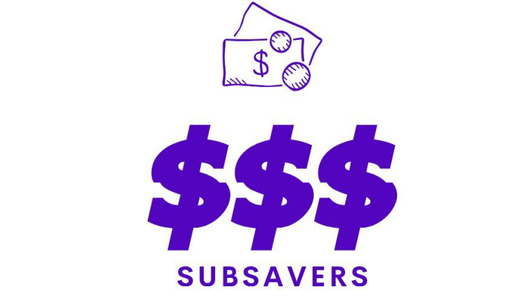

Slide 6


Subscription Tracking
AI Insights
Key Features
One Click Cancellation
Smart Reminders

Slide 7


[3] Juniper
Market competitors
“Subscription Economy to Be Worth Almost $1 Trillion Globally by 2028”
[3]
VS
Centralized Management
Subscription Tracker
Easy Cancellation
AI-Powered Insights
Smart Automation
Proactive Alerts

Slide 8




THANKYOU!!
Team SubSavers
Maryam Almetnawy
Ameera Saeed
Aya Hmoud
Team Leader
LinkedIn
Researcher
LinkedIn
App Designer
LinkedIn
OUR TEAM MEMBERS

